Slide 1


CSS BASICS

Slide 2



What is CSS?
Cascading Style Sheets
Describes how HTML elements are to be displayed
External style sheets are CSS files

Slide 3
3 Ways to write CSS
Inline CSS
Internal CSS
External CSS

Slide 4
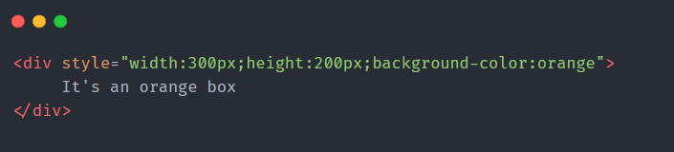
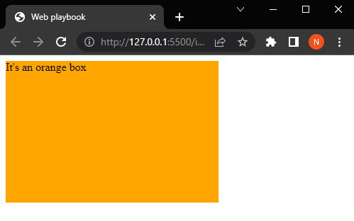
Inline CSS

Slide 5
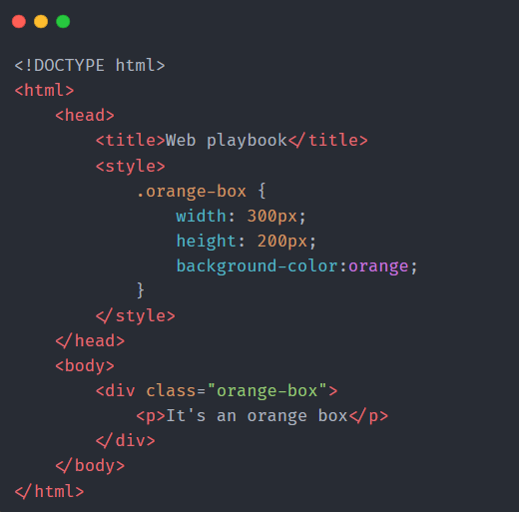
Internal CSS

Slide 6
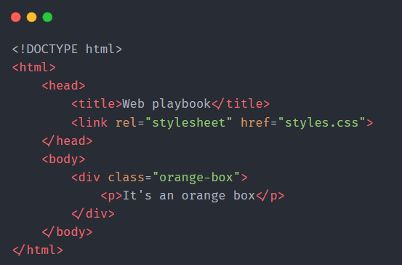
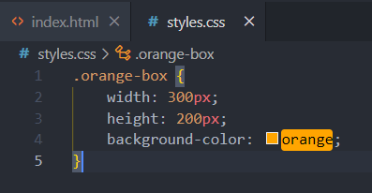
External CSS

Slide 7
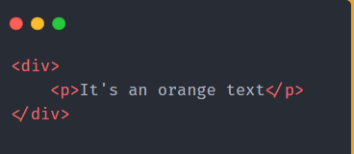
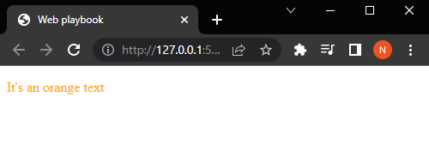
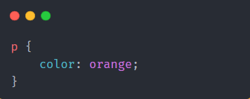
CSS Selectors
Element Selector

Slide 8
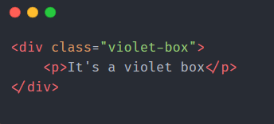
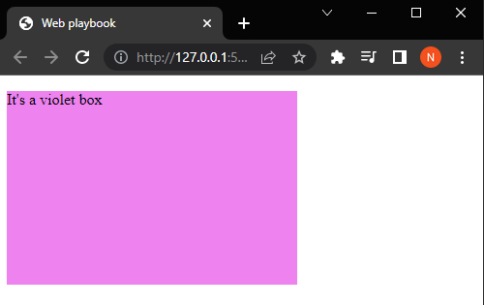
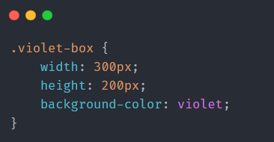
CSS Selectors
2. Class Selector

Slide 9
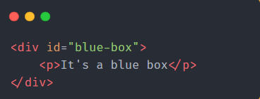
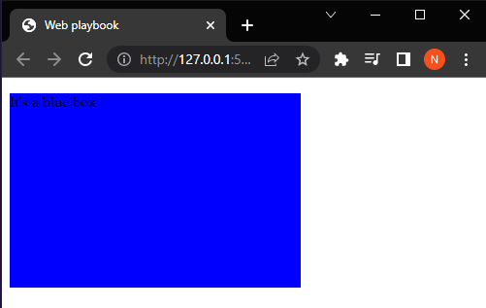
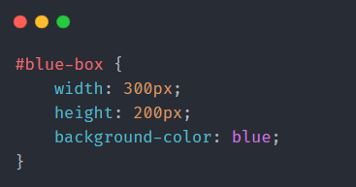
CSS Selectors
3. ID Selector

Slide 10
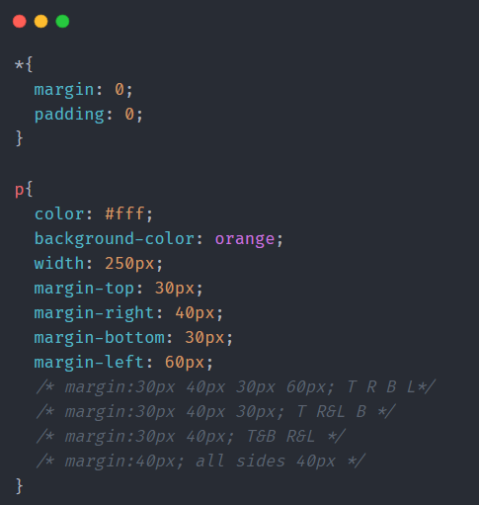
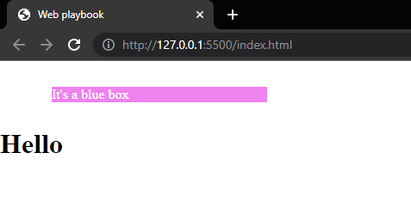
CSS Margins
30px
40px
60px
30px
To create space around elements
Horizontally center the element
within its container using auto

Slide 11
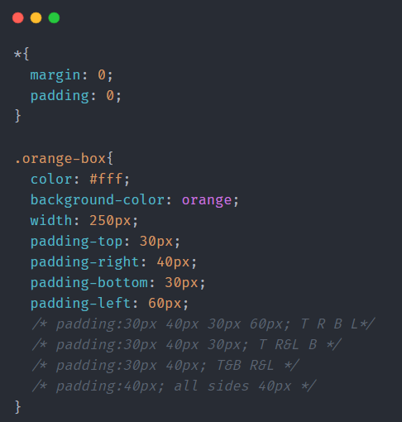
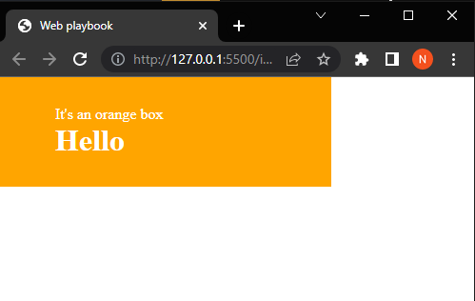
CSS Padding
30px
40px
60px
30px
To generate space within an element

Slide 12
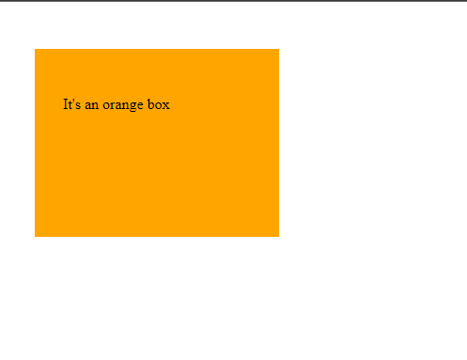
Margin vs Padding
50px
50px
30px
30px
30px
30px
50px
50px

Slide 13
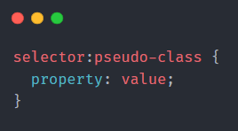
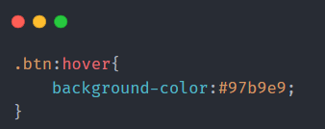


Pseudo Classes
Used to define a special state of an element.
focus
hover
visited
link
On hover

Slide 14
CSS Units
px : pixels
% : Relative to the parent element
em : Relative to the font-size of the element
rem : Relative to the font-size of the root element

Slide 15
CSS Display
Specifies how an element should be displayed
Every element has a default display property , block or inline
Block
Inline
<div>
<h1> - <h6>
<p>
<form>
<header>
<footer>
<section>
<span>
<a>
<img>
Display none is used to hide and show elements

Slide 16
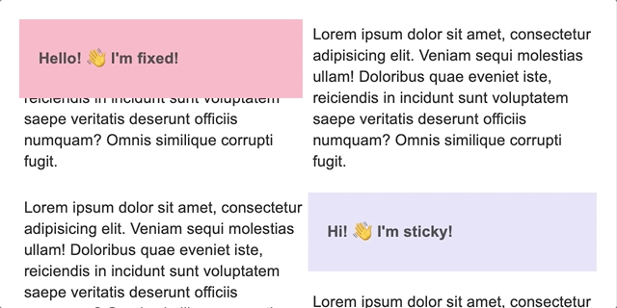

CSS Position
Specifies the type of positioning method used for an element
Fixed vs Sticky

Slide 17
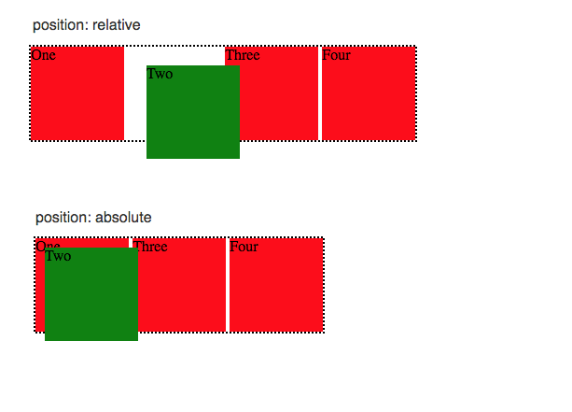
CSS Position
Relative vs Absolute

Slide 18
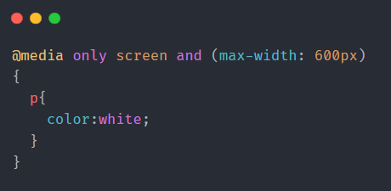
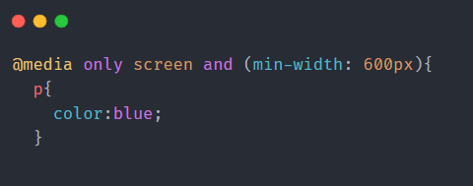
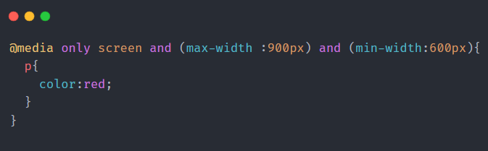
CSS Media Queries
They are used to apply specific styles to different devices

Slide 19
Resources
MDN-docs
W3 Schools

Slide 20
Time for Coding!

Slide 21
Try It Yourself
Challenge

Slide 22
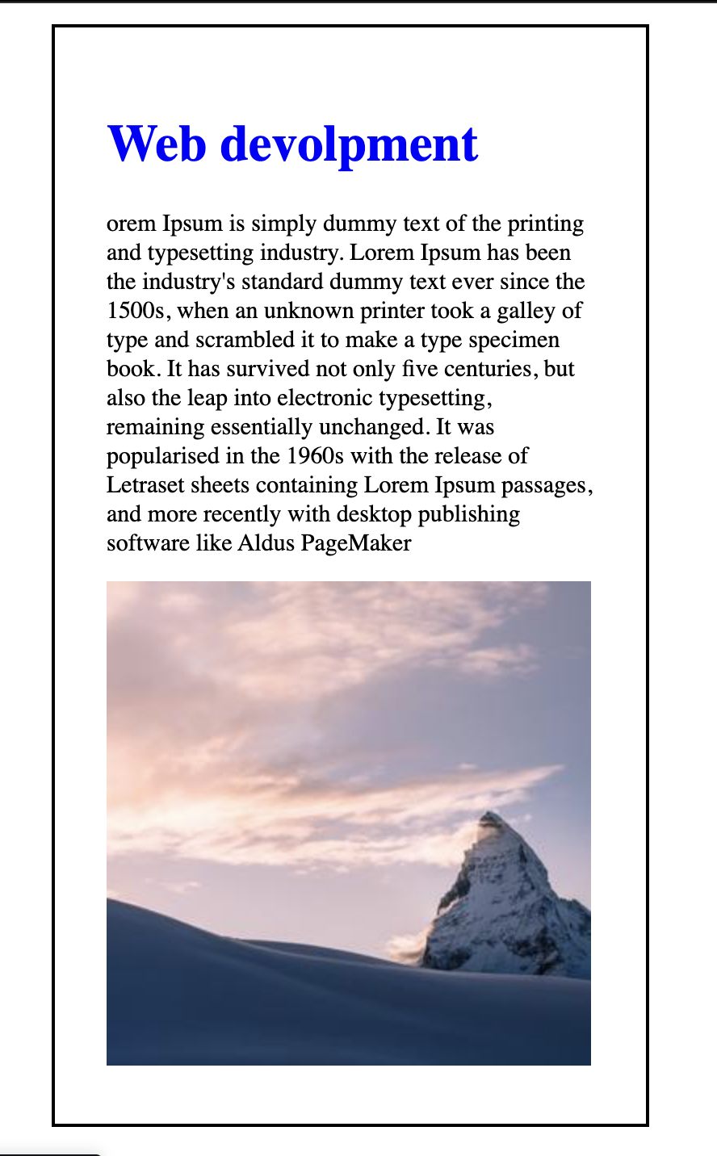
Try It Yourself Challenge
Create a card with a heading, a paragraph tag, and an image tag.
Make heading as blue color using class selectors
Modify the font size of the paragraph tag as 15px using id selector
Add a black border to the div element with the width specified as 30%, padding and margin as 2em using element selector.

